Slide 1
OSDU Concepts Demystifying OSDU

Slide 2
Concepts
What is an OSDU instance?

Slide 3
Concepts
APIS - core services, DDMS, ref +++, husk at search gir annet resultat enn storage
Concept of schema and WKS and Kind → data concept
Master data and ref data
Entitlements -> group-types (user, service, data; herunder acl) + governance, e.g. built in groups and custom, connection with IDP
Legal Tag – requirement, explain built in functionality, governance
Ingestion and consumption
Search/index er på plass
Versjonering er på plass
Namespace → system of engagement
Lineage provenance. Se tech assurance… stole på data
Existence kind…
Technical assurance

Slide 4
What is an OSDU instance?

Slide 5
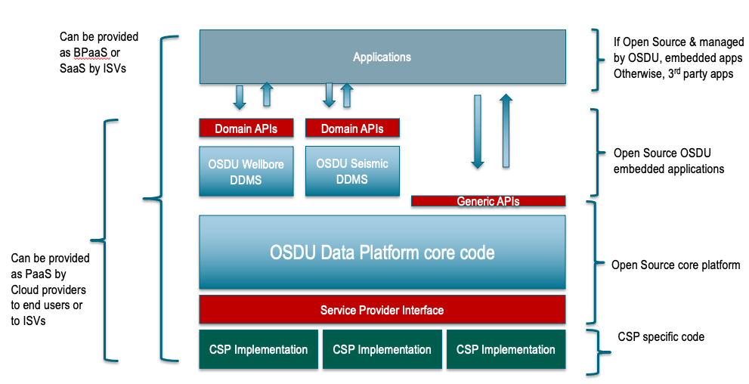
OSDU Data Platform Software Components

Slide 6
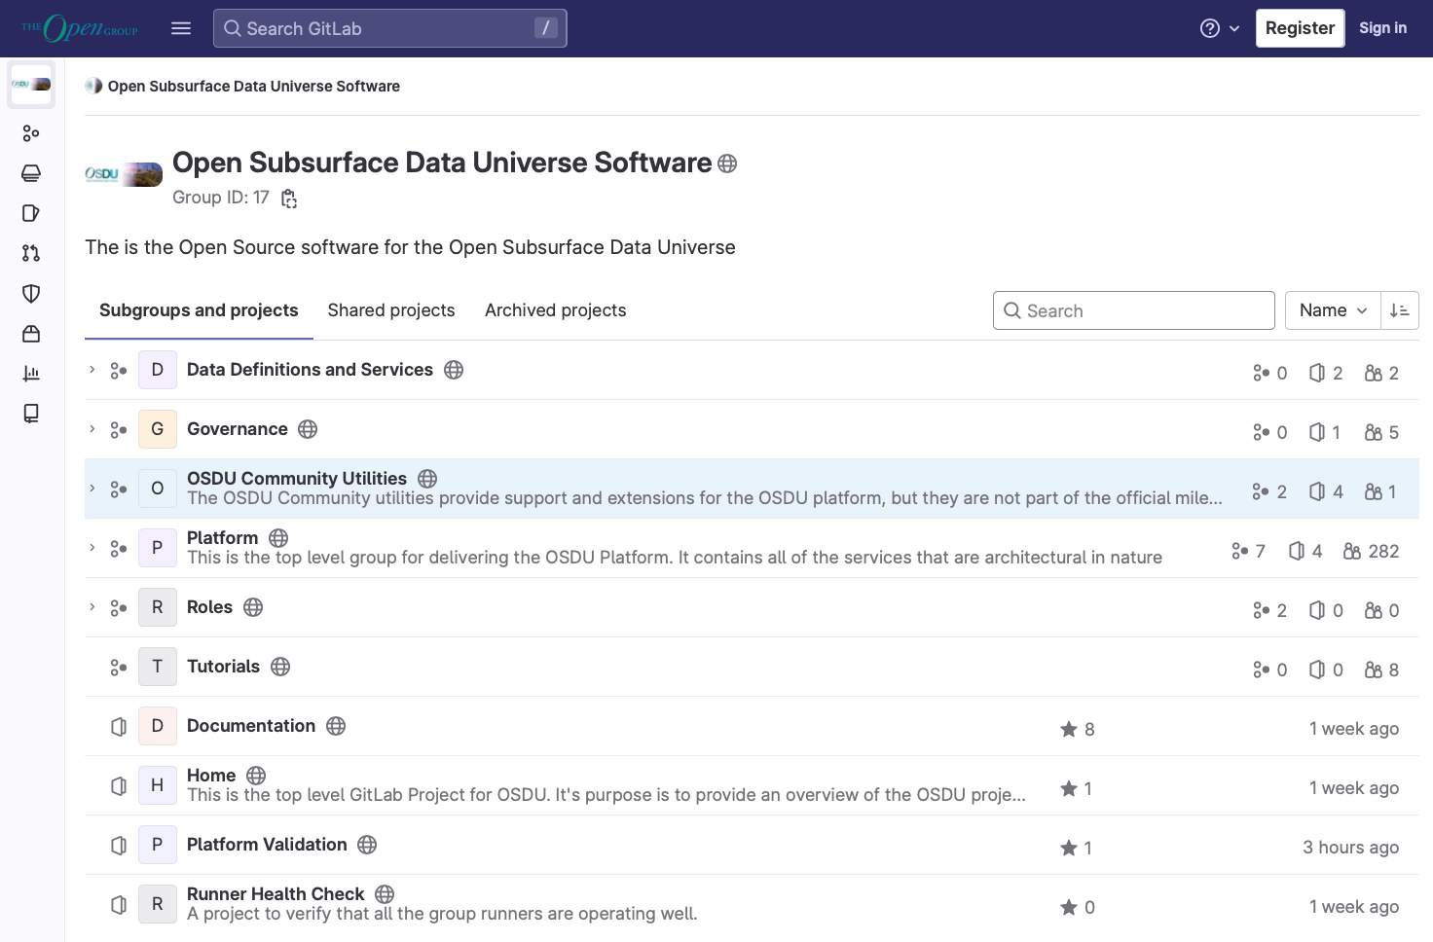
The code…
Platform Code

Slide 7
Demo
Where is the code?
Milestone-concept
Platform Code

Slide 8




Cloud Agnostic

Slide 9
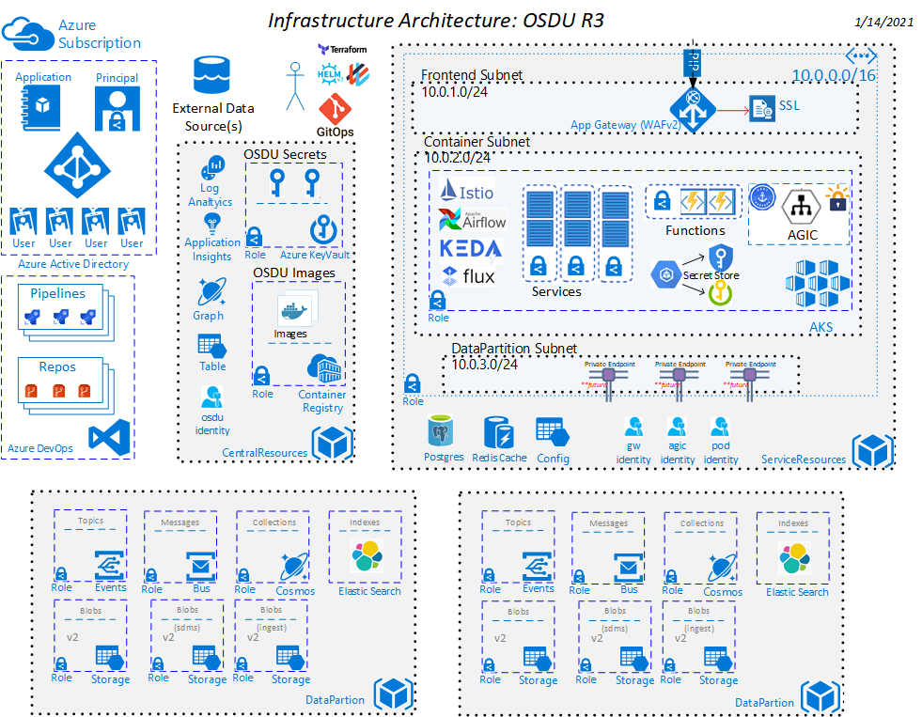
OSDU Behind the scenes

Slide 10
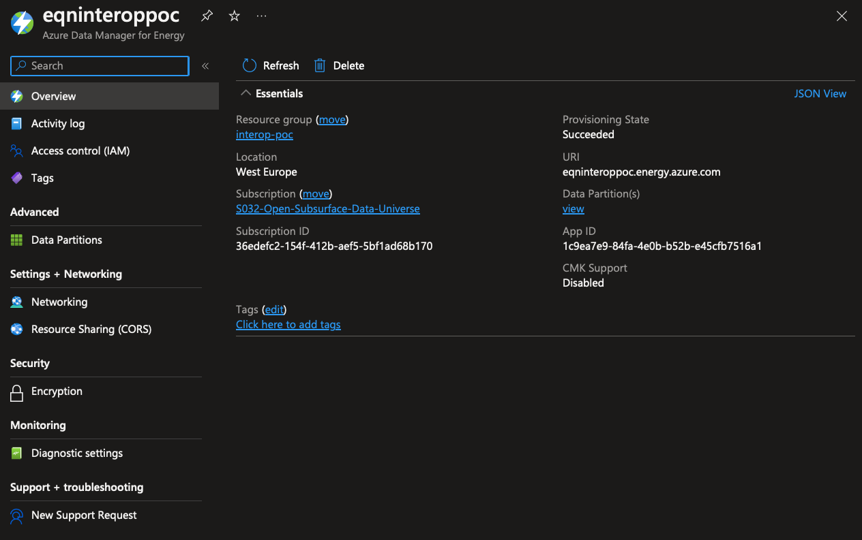
ADME

Slide 11
How can I communicate with my OSDU?

Slide 12
OSDU Data Platform Software Components

Slide 13
APIs only! (for now…?)

Slide 14
Where and how is my data stored?

Slide 15
Two main storages
Catalog
Archive

Slide 16
Two main storages
Catalog
Archive
DocumentDB
BinaryStore

Slide 17
Two main storages
Catalog
Archive
DocumentDB
BinaryStore
JSON
Binaries

Slide 18
Two main storages
File API
Storage API
Dataset API
Catalog
Archive
DocumentDB
BinaryStore
JSON
Binaries

Slide 19
“…main storages…”?

Slide 20
Two main storages
Catalog
Archive

Slide 21
DDMS optimized storage
Reservoir
DDMS
Wellbore
DDMS
Catalog
Archive
Seismic
DDMS

Slide 22
How to form records Well Known Schemas

Slide 23
Data structures
File API
Storage API
Dataset API
Catalog
Archive
DocumentDB
BinaryStore
JSON
Binaries

Slide 24
Data structures
Main data types
Master Data
Work Product Components
Reference Data
Work Product
Dataset
Storage API
Catalog
DocumentDB
JSON

Slide 25
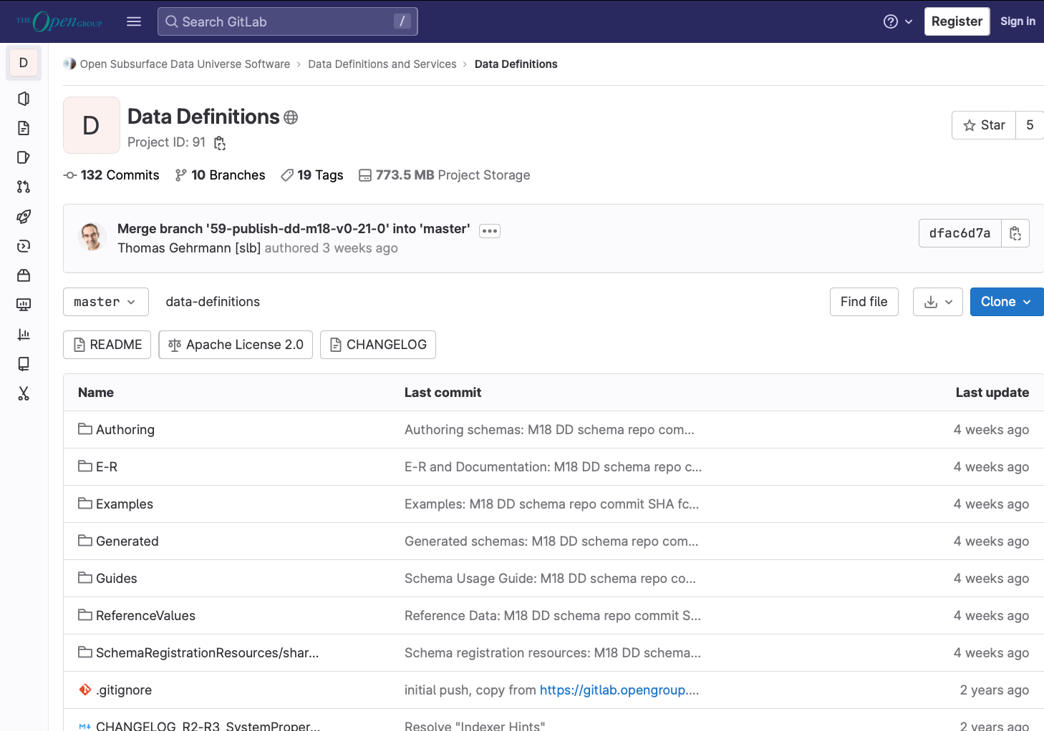
OSDU Data Concepts (prev known as definitions)
OSDU Data Concept

Slide 26
DEMO
Milestone
Schema version
Find schema definition
Schema Guideline
OSDU Data Concept

Slide 27
Reference data is a bit special…

Slide 28
How to define own data structures Custom schemas

Slide 29
Your schema in an OSDU wrapper
id
kind
version
acl
acl.owners[]
acl.viewers[]
legal
legal.legaltags[]
legal.otherRelevantDataCountries[]
legal.status
tags
createTime
createUser
modifyTime
modifyUser
ancestry
ancestry.parents[]
meta[]
data

Slide 30
Your schema in an OSDU wrapper
id
kind
version
acl
acl.owners[]
acl.viewers[]
legal
legal.legaltags[]
legal.otherRelevantDataCountries[]
legal.status
tags
createTime
createUser
modifyTime
modifyUser
ancestry
ancestry.parents[]
meta[]
data
Sample custom schema

Slide 31
Custom or not to custom…
Data type does not exist in WKS
Data type does not have fidelity in WKS
Dependency on other access regimes
Data is not immutable in source
OSDU Data Concept

Slide 32
How do we control access?

Slide 33
Entitlements
users
users.data.root
users.datalake.viewers
users.datalake.editors
users.datalake.ops
users.datalake.admins
service.dataset.editors
service.workflow.creator
service.search.admin
service.workflow.admin
service.legal.user
service.legal.admin
service.plugin.user
service.workflow.viewer
service.storage.admin
service.storage.viewer
service.policy.user
service.secret.viewer
service.search.user
service.dataset.viewers
service.schema-service.editors
service.edsdms.user
service.legal.editor
service.status-publisher.editors
service.policy.admin
service.entitlements.admin
service.file.editors
users
users.datalake.ops
data.default.viewers
data.default.owners
service.schema-service.viewers
service.entitlements.user
users.datalake.editors
service.storage.creator
service.messaging.user
users.datalake.admins
service.status-publisher.viewers
service.schema-service.admin
service.file.viewers

Slide 34
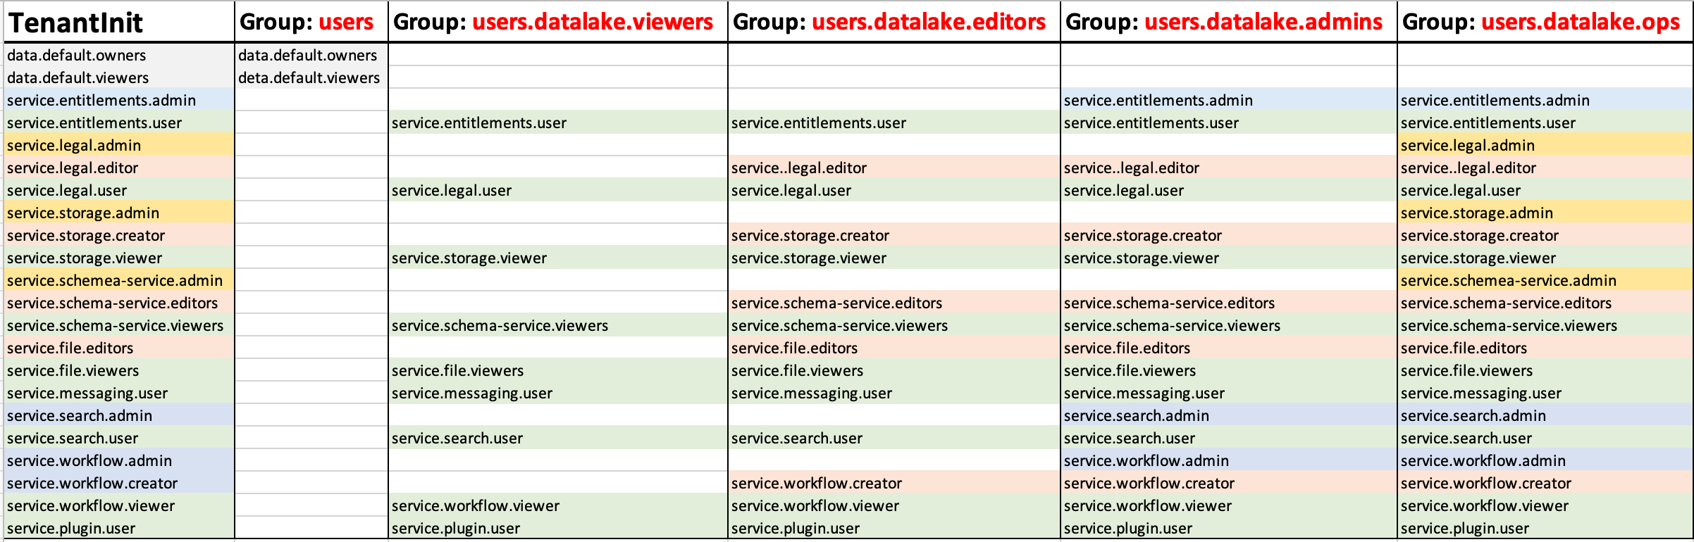
Entitlements
OSDU Data Concept

Slide 35
My favorite, the Legal Tag… not…

Slide 36
Is it possible to do versioning?

Slide 37
Versioning
Milestone-version
Schema-version
API-version
Record-version
OSDU Data Concept

Slide 38
API-versioning

Slide 39
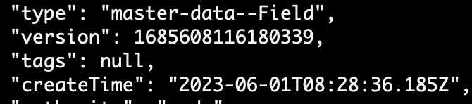
Record-versioning

Slide 40
When to…
Create new version of a record
vs
Create new instance of a record
OSDU Data Concept

Slide 41
What about tracing lineage?

Slide 42
Lineage
Versioning
Ancestry
Lineage assertion
Source
Dataset
Activity-model
OSDU Data Concept

Slide 43
How can I find my data?

Slide 44
Indexer and search
Elasticsearch
Indexer-hints
Extension properties
(to-be) Custom indexing

Slide 45
We got the tools, how do we ingest?

Slide 46
Write data records
File
Dataset
Workflow
Storage
DDMS

Slide 47
How is it meant to be used?

Slide 48
Is it meant to be a
System of Records
or
System of Engagement
or
System of Reference
OSDU Data Concept

Slide 49

DON’T
PANIC

Slide 50
Questions?

